Slide 1
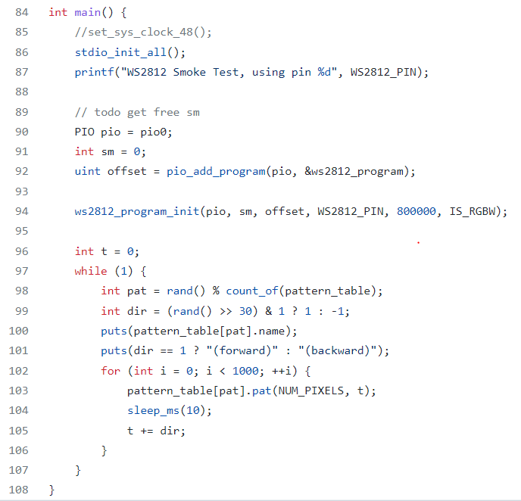
1
Initialize all the present standard stdio types that are linked into the binary.
2
Warn or specific which pin is assigned. Usually, a default pin is used but we had defined particularly so.
3
Selects the PIO instance to be used.
4
Assigns a state machine to execute the program.
5
Finds a location in PIO’s instruction memory with enough space for the program.
6
Starts and configures the program.
22
Defines a variable t and assigns the value.
23
Begins a while loop which takes action when the LED is on.
24
Selects a random number in count of table.
25
Checks the logic and takes 1 otherwise -1.
26
Writes the string to stdout.
30
If dir is 1 it writes forward string else backward.
31
Starts the for loop.
32
Executes the main function and calls different cases depending upon the pat number.
40
Rest or keep constant for 10.
41
Amend the value of t.

Slide 2
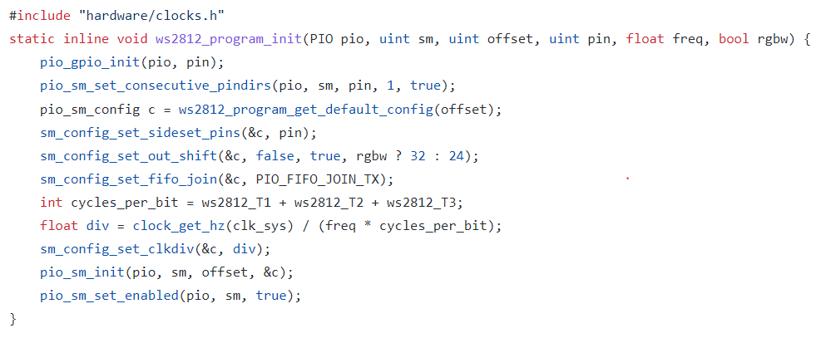
7
This sets up a function to enable and direct GPIO to use output from the specified PIO instance.
8
Using the state machine to align the direction of consecutive pins equally.
9
Sets the state machine configuration.
14
Sets the sideset pin in state machine configuration.
15
Setup the out shifting parameter.
16
Setup the FIFO joining.
17
Adds up the cycle time.
18
19
Sets the state machine clock divider.
20
Resets and configures the state machine.
21
Enables the state machine as the value is set to be true.

Slide 3
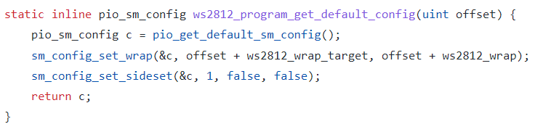
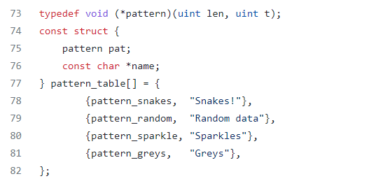
10
Calls the default state machine configuration.
11
Adds and sets the warp addresses.
12
Sets the sideset options.
13
Returns the new configuration.
27
Creates a function without any returns.
28
Constructs a table.
29
Combines all the functions above and gives them labels.

Slide 4
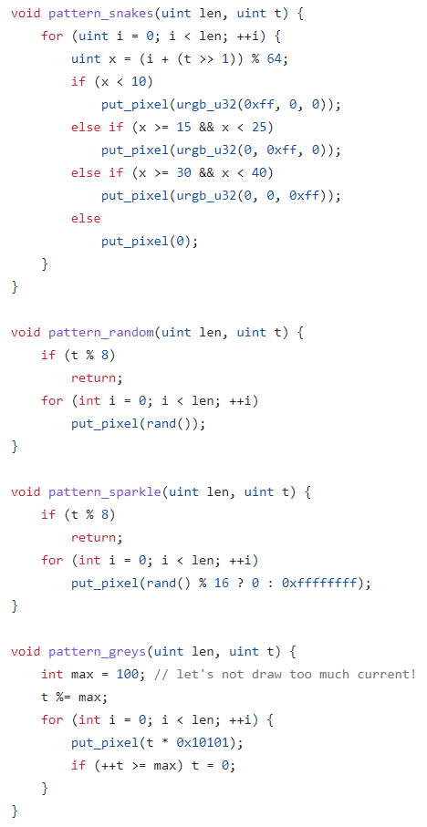
Case 1.
33 - 39
This creates a color pattern based on the x values that comes.
Case 2.
33 - 35
Gives random color output.
33 - 35
Will blink if the random number is divisible by 16.
Case 3.
Case 4.
33 - 36
Color pattern based on value of t and resets as t equals or exceeds max value.

